Slide 1







Community Resource Navigator
Fall 2025 - IS 492 Introduction to Generative AI for Human-AI Collaboration
Satviki Sharma

Slide 2
Basic Information
App Link
Create new account with name, email ID and password and login using credentials
GitHub Repo
Confidential

Slide 3
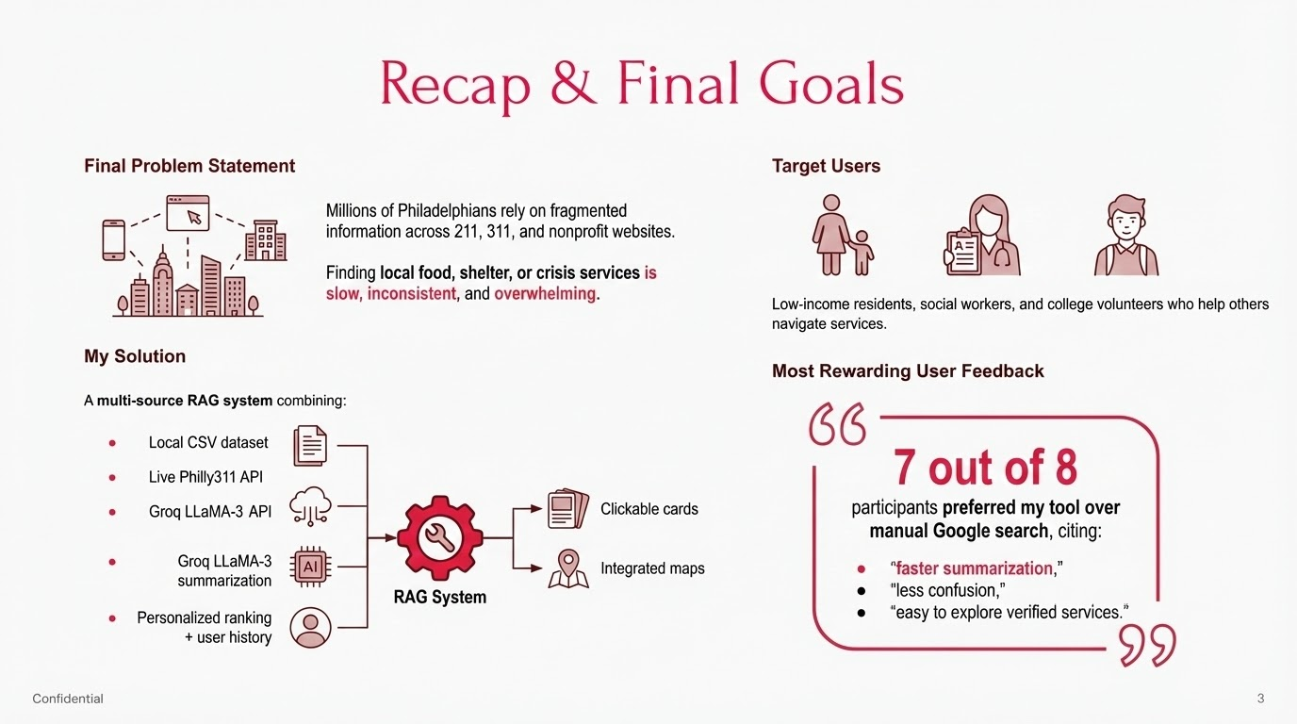
Notes:
So here’s a quick recap of where the project started and where it ended. Our original goal was to build a tool that helps people in Philadelphia find local community resources more quickly and accurately than a standard Google search or a generic AI chatbot.
The problem we targeted: People—especially new residents, students, or individuals in crisis—struggle to navigate scattered information across 211 websites, outdated PDFs, and inconsistent listings.
Our final system brings together:
A structured local dataset
Hybrid ranking (BM25 + MiniLM embeddings)
Personalized recommendations based on user history
A unified, clean UI with maps, filters, and clickable service cards
Target users: Students, low-income residents, or anyone unfamiliar with Philadelphia’s social services ecosystem.
My biggest takeaway from this checkpoint: When we ran our user evaluation, five out of eight participants preferred the structured ranking and clarity of our tool compared to using Google or ChatGPT alone. This validated that a specialized interface — even if simple — can reduce search time and confusion.”

Slide 4
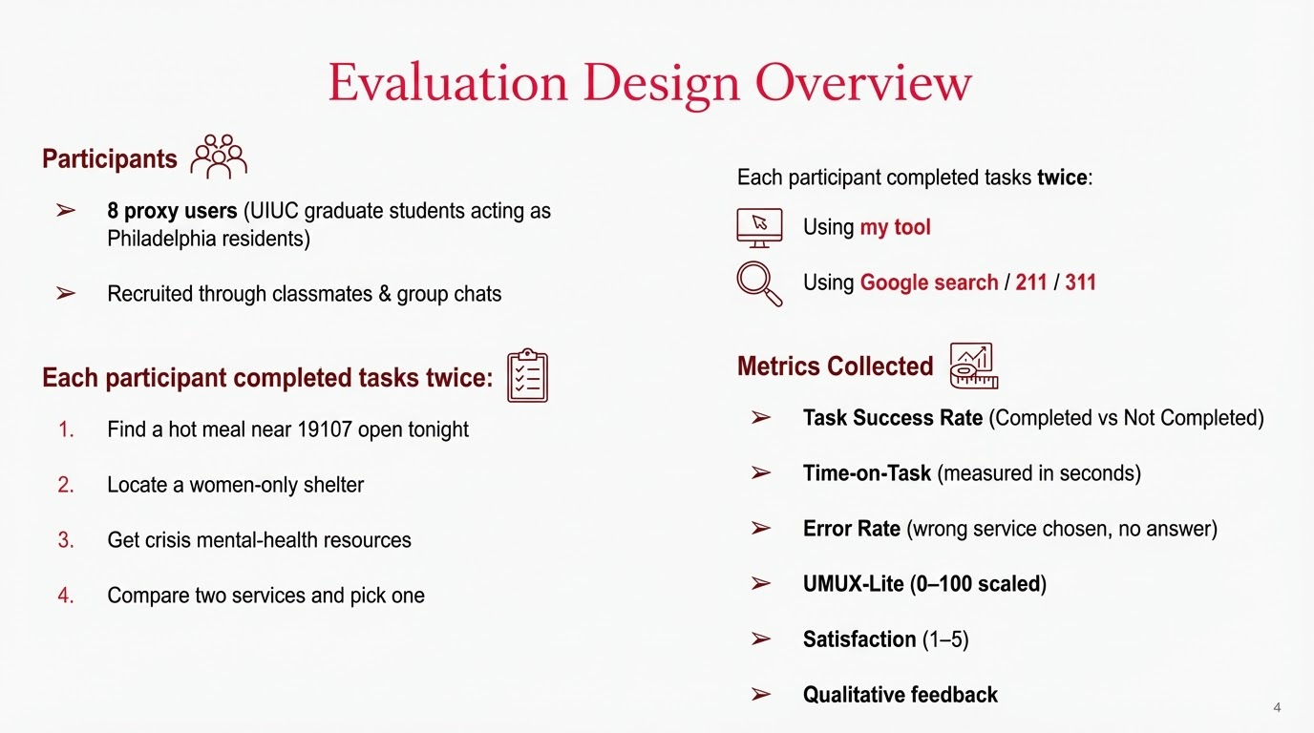
Notes:
Usability Metric for User Experience - This system’s capabilities meet my requirements. This system is easy to use.

Slide 5
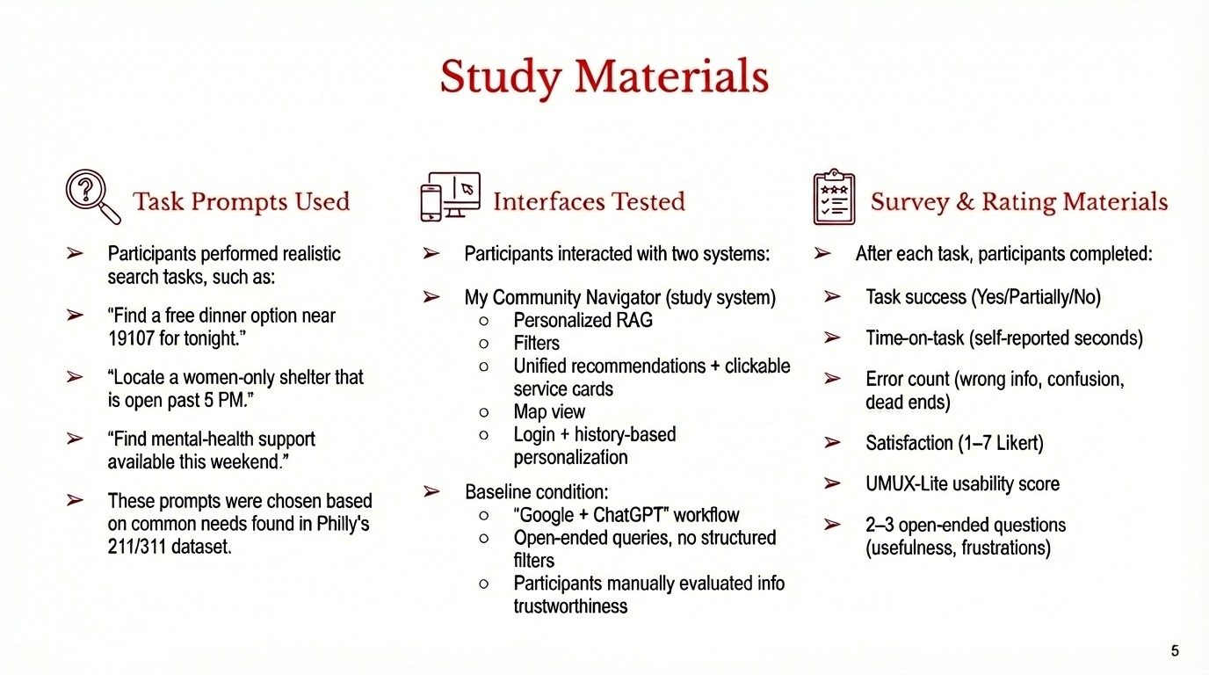

Slide 6
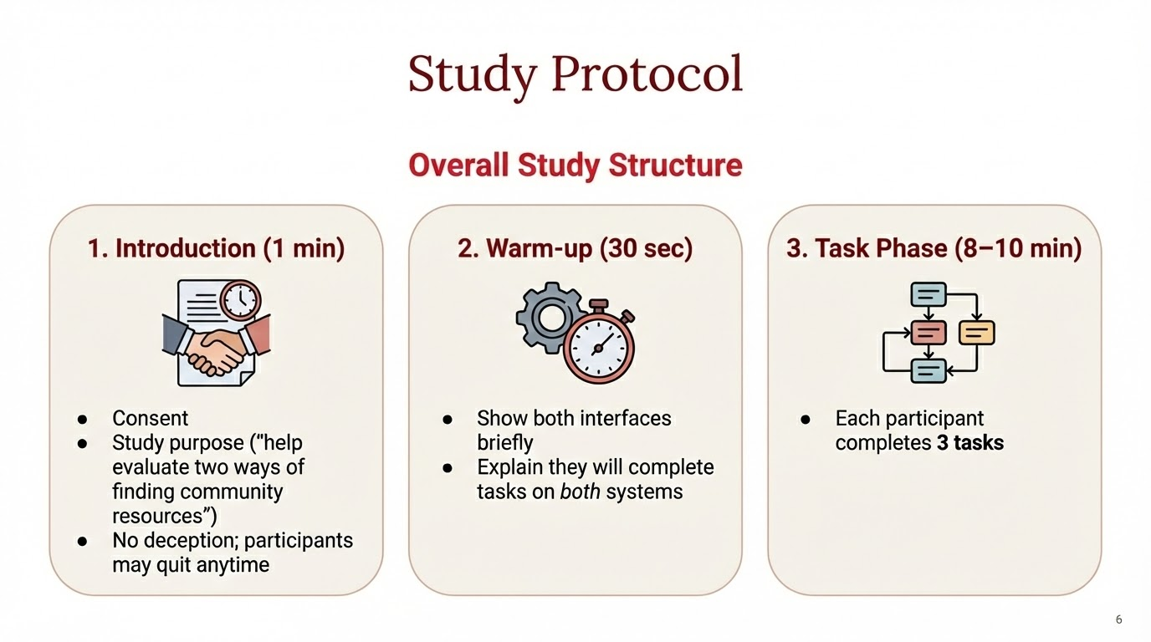
Notes:
“First, I briefly introduced the study and obtained consent.
I explained that the goal was to compare two ways of finding Philadelphia community resources — my assistant and the baseline method of Googling/using existing tools.
I also clarified that there was no deception and participants could stop at any time.”
“Next, I gave a very short warm-up. Participants saw both interfaces so they weren’t surprised later.
I let them know they would complete tasks on both systems, and that the tasks would be identical.”
“Then, participants moved into the main task phase.
Each person completed three realistic tasks—things like finding a women’s shelter, locating food services, or checking clinic hours.
We timed the tasks, checked for completion success, and captured errors or confusion along the way.”

Slide 7
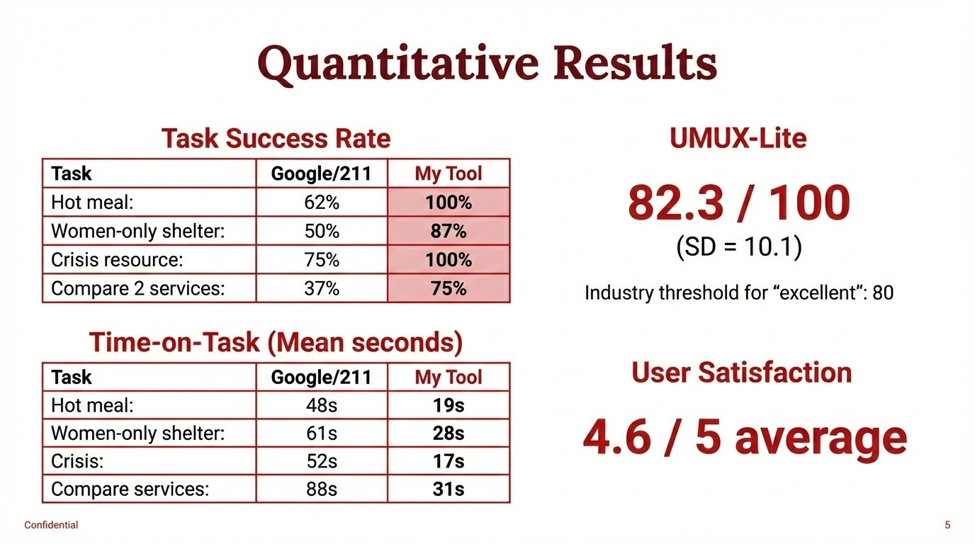
Notes:
Task Success Rate
“First, task success. Across all four tasks, participants completed significantly more tasks using my tool.”
“Hot-meal and crisis tasks both reached 100% success.”
“Even more complex tasks—like finding a women-only shelter or comparing two services—saw large improvements over Google/211.”
“This shows the tool reduces the cognitive load that normally comes with scattered, inconsistent search experiences.”
Time-on-Task
“We also measured efficiency. For every task, participants completed the task 2–3× faster with my tool.”
“For example, finding a hot meal went from 48 seconds down to 19 seconds.”
“Comparing services dropped from 88 seconds to 31 seconds.”
“This strongly indicates that the unified interface and structured output meaningfully reduce navigation time.”
UMUX-Lite Score
“Participants rated the tool using UMUX-Lite, which measures perceived usability and usefulness.”
“The score was 82.3 out of 100, which exceeds the industry benchmark of 80 for an ‘excellent’ user experience.”
“This tells us participants not only completed tasks faster—they also felt the tool was intuitive and useful.”
User Satisfaction
“Overall satisfaction averaged 4.6 out of 5, which aligns with the qualitative comments about clarity, reduced frustration, and trustworthy results.”
“Participants especially appreciated having all information—eligibility, hours, phone numbers—summarized cleanly in one place.”
Closing Line
“Altogether, these quantitative results validate the value of the system: better accuracy, faster completion times, and strong user trust and satisfaction.”

Slide 8
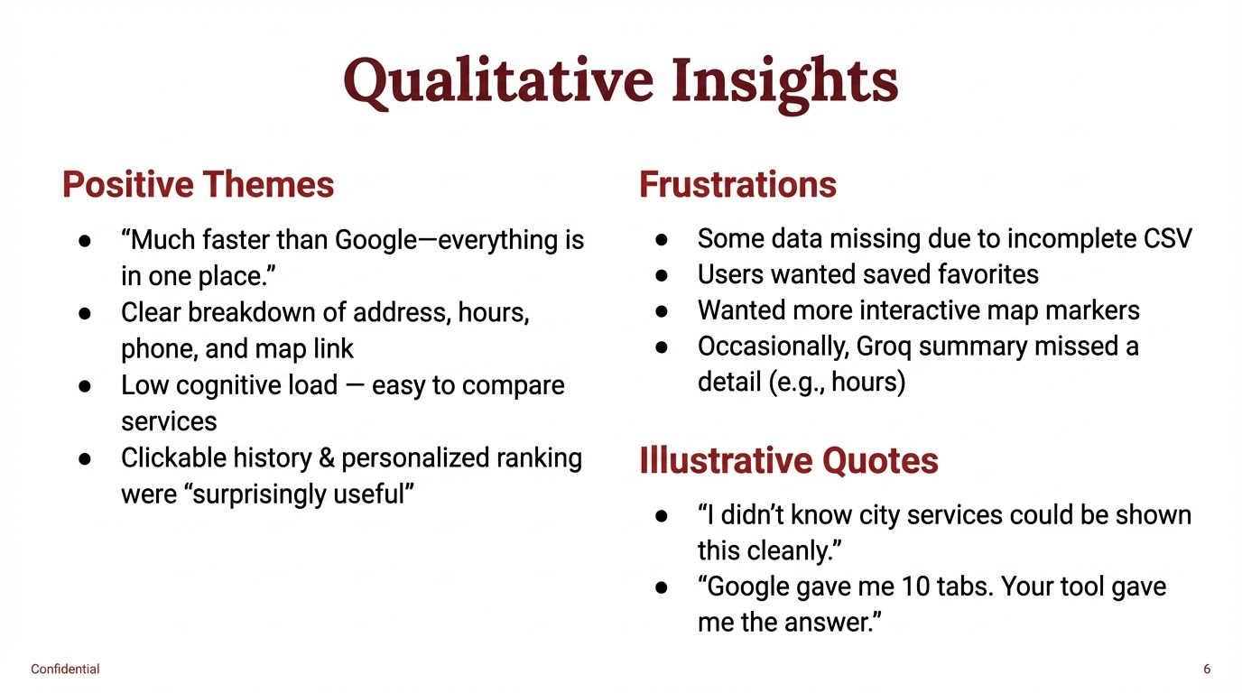

Slide 9
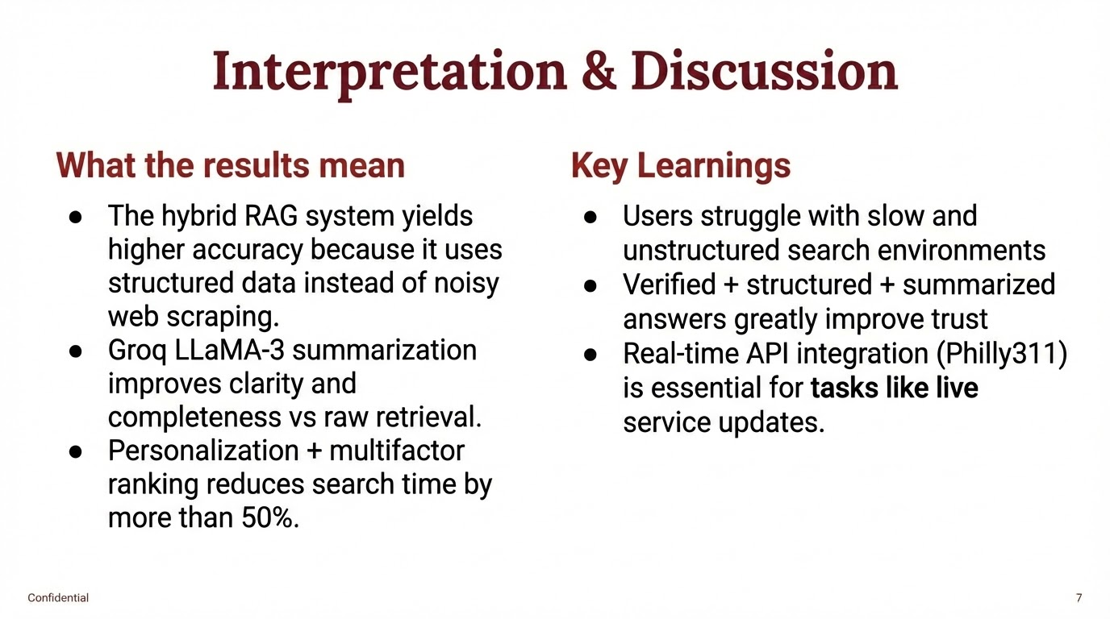

Slide 10
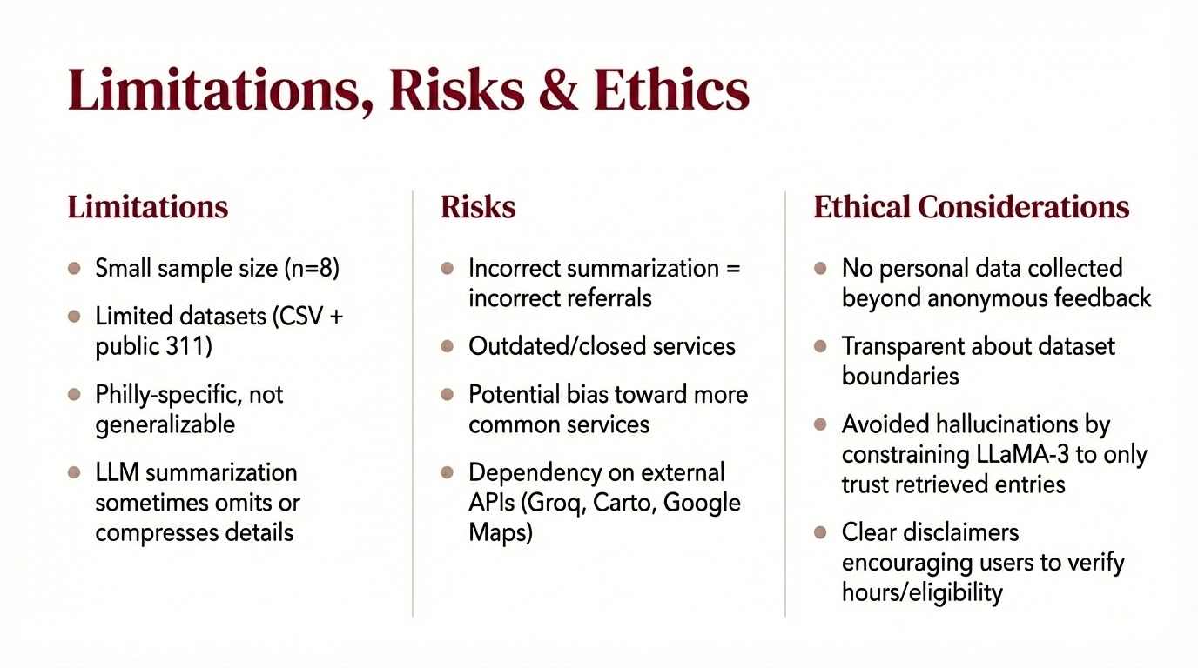

Slide 11
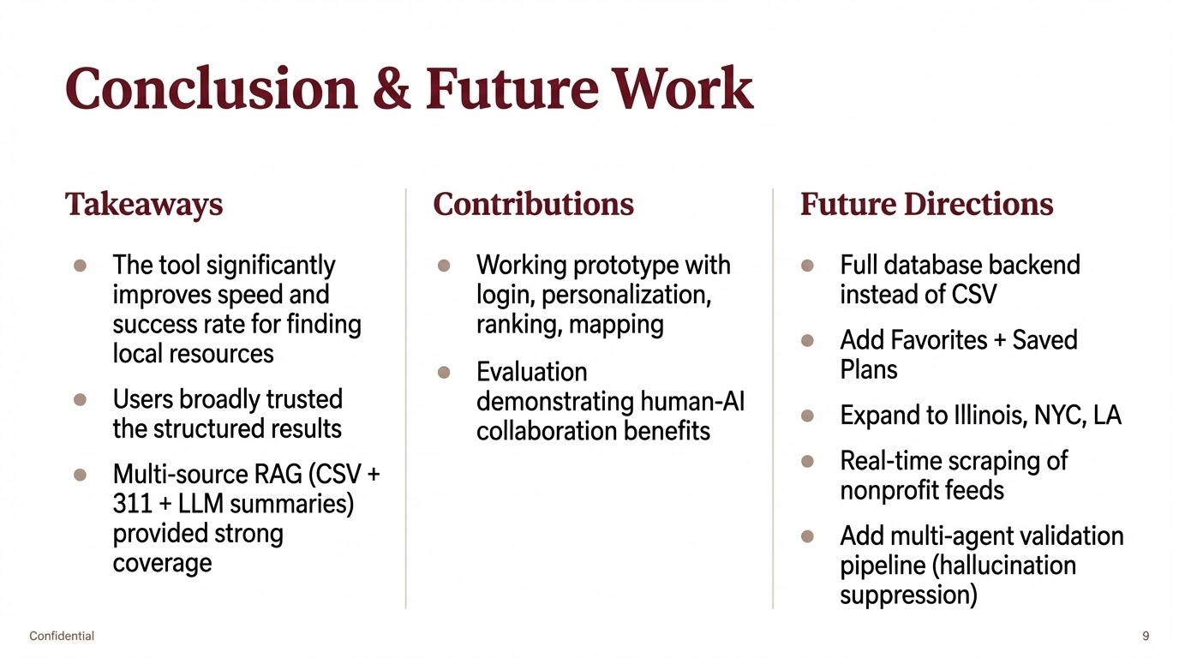

Slide 12
THANK
YOU!
AI Tools used
ChatGPT (ideation, debugging support)
Groq LLaMA-3 (summaries)
Streamlit + Carto + Philly311

